Slide 1
Unit 4

Slide 2
Scaling
To change the size of an object, scaling transformation is used.
In the scaling process, you either expand or compress the dimensions of the object.
Scaling can be achieved by multiplying the original coordinates of the object with the scaling factor to get the desired result.
Let us assume that the original coordinates are X,Y, the scaling factors are (SX, SY), and the produced coordinates are X′,Y′.
This can be mathematically represented as shown below −
X' = X . SX and Y' = Y . SY

Slide 3
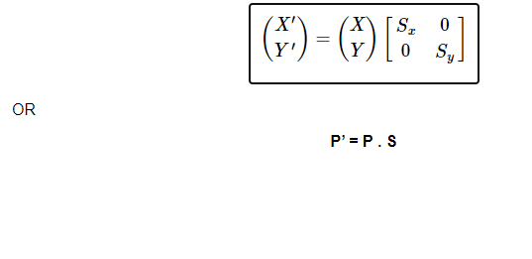
The scaling factor SX, SY scales the object in X and Y direction respectively. The above equations can also be represented in matrix form as below − Where S is the scaling matrix. The scaling process is shown in the following figure.

Slide 4
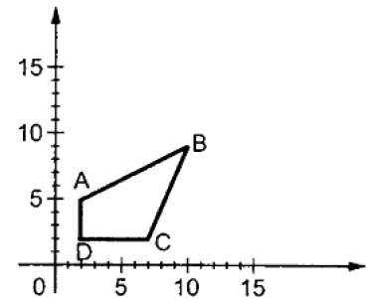
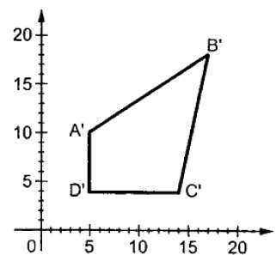
If we provide values less than 1 to the scaling factor S, then we can reduce the size of the object. If we provide values greater than 1, then we can increase the size of the object.

Slide 5
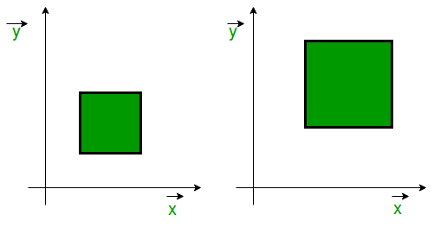

Slide 6
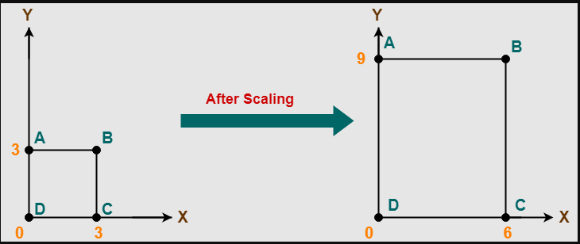

Slide 7
Problem-01:
Given a square object with coordinate points A(0, 3), B(3, 3), C(3, 0), D(0, 0). Apply the scaling parameter 2 towards X axis and 3 towards Y axis and obtain the new coordinates of the object.

Slide 8
Solution-
Given-
Old corner coordinates of the square = A (0, 3), B(3, 3), C(3, 0), D(0, 0)
Scaling factor along X axis = 2
Scaling factor along Y axis = 3
For Coordinates A(0, 3)
Let the new coordinates of corner A after scaling = (Xnew, Ynew).
Applying the scaling equations, we have-
Xnew = Xold x Sx = 0 x 2 = 0
Ynew = Yold x Sy = 3 x 3 = 9
Thus, New coordinates of corner A after scaling = (0, 9).

Slide 9
For Coordinates B(3, 3)
Let the new coordinates of corner B after scaling = (Xnew, Ynew).
Applying the scaling equations, we have-
xnew = Xold x Sx = 3 x 2 = 6
Ynew = Yold x Sy = 3 x 3 = 9
Thus, New coordinates of corner B after scaling = (6, 9).

Slide 10
For Coordinates C(3, 0)
Let the new coordinates of corner C after scaling = (Xnew, Ynew).
Applying the scaling equations, we have-
Xnew = Xold x Sx = 3 x 2 = 6
Ynew = Yold x Sy = 0 x 3 = 0
Thus, New coordinates of corner C after scaling = (6, 0).

Slide 11
For Coordinates D(0, 0)
Let the new coordinates of corner D after scaling = (Xnew, Ynew).
Applying the scaling equations, we have-
Xnew = Xold x Sx = 0 x 2 = 0
Ynew = Yold x Sy = 0 x 3 = 0
Thus, New coordinates of corner D after scaling = (0, 0).
Thus, New coordinates of the square after scaling = A (0, 9), B(6, 9), C(6, 0), D(0, 0).

Slide 12
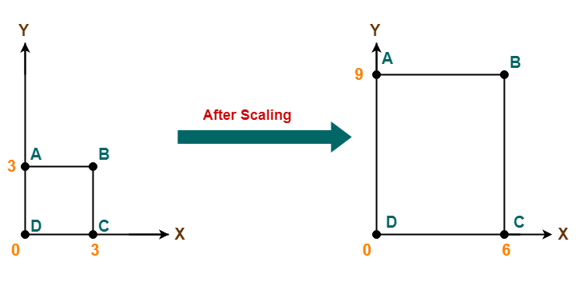

Slide 13
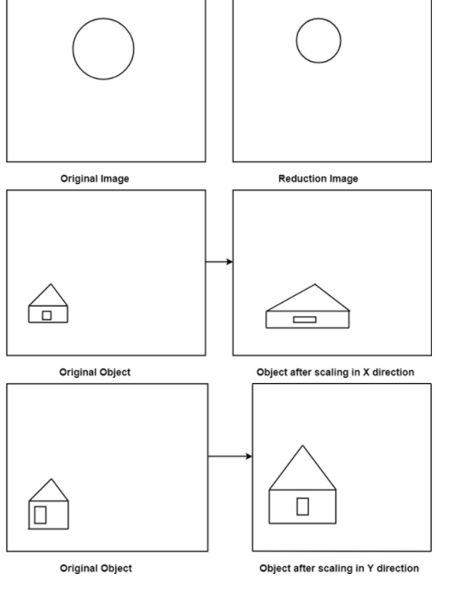

Slide 14
Example: A Square object with the coordinate points P (1, 4), Q (4, 4), R (4, 1), T (1,1). Apply the scaling factor 3 on the X-axis and 4 on the Y-axis. Find out the new coordinates of the square?
Solution: We have,
Coordinates Points for Square = P (1, 4), Q (4, 4), R (4, 1), S (1, 1)
Scaling factor along with X axis (Sx) = 3
Scaling factor along with Y axis (Sy)= 4
Applying the equation to find the new coordinates-
For Coordinate P (1, 4)–
Let the new Coordinate for P = (P1, Q1)
P1 = P0. Sx = 1 x 3 = 3
Q1 = Q0. Sy = 4 x 4 = 16
The new Coordinates = (3, 16)

Slide 15
For Coordinate Q (4, 4)–
Let the new Coordinate for Q = (P,₁ Q₁)
P₁ = P₀. Sx = 4 x 3 = 12
Q₁ = Q₀. Sy = 4 x 4 = 16
The new Coordinates = (12, 16)

Slide 16
For Coordinate R (4, 1)–
Let the new Coordinate for R = (P₁, Q₁)
P₁ = P₀. Sx = 4 x 3 = 12
Q₁ = Q₀. Sy = 1 x 4 = 4
The new Coordinates = (12, 4)

Slide 17
For Coordinate S (1, 1)–
Let the new Coordinate for S = (P₁, Q₁)
P₁ = P₀. Sx = 1 x 3 = 3
Q₁ = Q₀. Sy = 1 x 4 = 4
The new Coordinates = (3, 4)

Slide 18
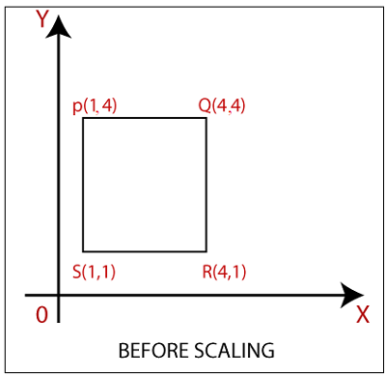

Slide 19
